Slide 1
SQL Server on Amazon RDS Building on the Amazon Web Services Cloud Platform
John McCormack

Slide 2
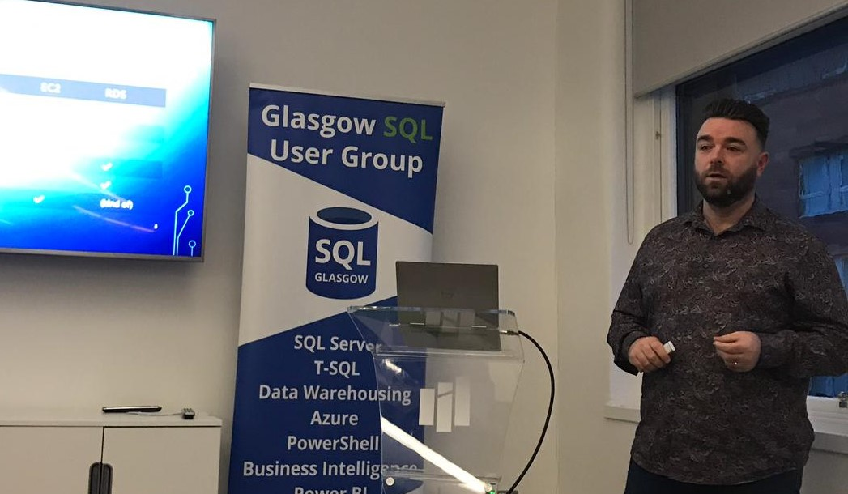
John McCormack
John McCormack is an experienced SQL Server and AWS professional.
He has been working as a DBA since 2012. He speaks at SQL Server User Group and conferences around the UK and Europe.
MCSE: Data Management and Analytics
AWS Certified Cloud Solutions Architect : Assoc

Slide 3
Understanding SQL SERVER on RDS
Learn the limitations and benefits of RDS
Understand important AWS terminology
Create and configure a SQL Server RDS Instance
Configure advanced options using parameter groups
Secure your RDS instance to a professional level
Backup your data, and restore it when needed
Monitor your instances using CloudWatch
Automate deployments using PowerShell

